Slide 1
CSC 3210 Computer Organization and Programming
Lab Work 9
Dr. Zulkar Nine
mnine@gsu.edu
Georgia State University
Spring 2021

Slide 2
Learning Objective
Indirect Addressing & Indexed Operands, Loop instruction, and Logical Instructions

Slide 3
Disclaimer
The process shown in these slides might not work in every single computer due to Operating system version, Microsoft Visual Studio versions and everything.
If you find any unusual error, you can inform the instructor.
Instructor will help you resolve the issue.

Slide 4
Attendance!

Slide 5
Lab Work 9 Instructions
Lab 9(a) : Indirect Addressing & Indexed Operands
Lab 9(b): Loop instruction
Lab 9(c): Nested Loop
Lab 9(d): Logical Instruction
Due Date: 03/19/21 11:59 PM

Slide 6
Plan early …
You have one week time to submit the lab
Start early
If you have issues
Email TA or instructor
Stop by during office hours
Start working at the last moment is not a good idea.
AppendixA shows how to check memory data and Appendix B shows how to create a new project.

Slide 7
Problems in this lab
Before running the problems in Visual studio,
You can try to solve them in a paper for practice.
You might see similar questions in the quizzes and exam.
During the exam you might need solve similar problems without visual studio.

Slide 8
Directions
Create a new application for every question.
Do not use one application with multiple .asm files
The Appendix has the steps for creating a new project

Slide 9
Lab 9(a) Indirect Addressing & Indexed Operands
Submission

Slide 10
Indirect Addressing & Indexed Operands
Problem 1: Write and run a program to find the values of each destination operand:
.code
mov esi,OFFSET myBytes
mov al,[esi] ; indirect access ; a. AL =
mov al,[esi+3] ; b. AL =
mov esi,OFFSET myWords + 2
mov ax,[esi] ; c. AX =
mov edi,8 ; indexed Operand
mov edx,[myDoubles + edi] ; d. EDX =
mov edx,myDoubles[edi] ; e. EDX =
mov ebx,myPointer
mov eax,[ebx+4] ; f. EAX =
.data
myBytes BYTE 10h,20h,30h,40h
myWords WORD 8Ah,3Bh,72h,44h,66h
myDoubles DWORD 1,2,3,4,5
myPointer DWORD myDoubles

Slide 11
Submission Instruction - 9(a)
Debug through each line of code.
Execute the instruction
Take a screenshot of the code and register window
Record the line number, instruction, Register values in the answer sheet.
Also add the screenshot
Then explain the register or memory contents.

Slide 12
Lab 9(b) Loop instruction
Submission

Slide 13
Loop Instruction
Problem 2: Write and run a program to find the values of each destination operand:
; Summing an Array (SumArray.asm)
.data
intarray DWORD 10000h,20000h,30000h,40000h
.code
main PROC
mov edi,OFFSET intarray ; 1: EDI = address of intarray
mov ecx,LENGTHOF intarray ; 2: initialize loop counter
mov eax,0 ; 3: sum = 0
L1: ; 4: mark beginning of loop
add eax,[edi] ; 5: add an integer
add edi,TYPE intarray ; 6: point to next element
loop L1 ; 7: repeat until ECX = 0
EAX =?

Slide 14
Submission Instruction – 9(b)
Debug until you reach “INVOKE ExitProcess, 0”.
Take a screenshot of the code and register window at the end
Record the content of the EAX register
Then explain the register content.

Slide 15
Lab 9(c) Nested loop
Submission

Slide 16
Nested Loop
Problem 3: Write and run a program to find the values of each destination operand:
.data
temp dword ?
.code
mov eax,0
mov ecx,10 ; outer loop counter
L1:
mov eax,3
mov temp,ecx
mov ecx,5 ; inner loop counter
L2:
add eax,5
loop L2 ; repeat inner loop
mov ecx, temp
loop L1 ; repeat outer loop
EAX =?

Slide 17
Submission Instruction – 9(c)
Debug until you reach “INVOKE ExitProcess, 0”.
Take a screenshot of the code and register window at the end
Record the EAX register.
Also add the screenshot
Then explain the EAX register content.

Slide 18
Lab 9(d) Logical Instructions
Submission

Slide 19
Logical Instructions
Problem 4: Write and run a program to find the values of each destination operand:
.code
mov al,01101111b
and al,00101101b ; a. Al=
mov al,6Dh
and al,4Ah ; b. Al=
mov al,00001111b
or al,61h ; c. Al=
mov al,94h
xor al,37h ; d. Al=

Slide 20
Submission Instruction – 9(d)
Debug through each line of code.
Execute the instruction
Take a screenshot of the code and register window
Record the line number, instruction, Register values in the answer sheet.
Also add the screenshot
Then explain the register or memory contents.

Slide 21
Appendix A
Checking Memory Data

Slide 22
Checking Memory Data
Use Memory window to verify the values of memory locations.
To activate Memory window, run the debugger, go to debug menu and click on windows, open it, go to Memory then choose Memory1.
When you run your program and step over every line you will see the changed values marked with red color.
You Must be in the Debugging Mode to see the memory or the register window

Slide 23
Checking Memory Data
To activate Memory window,
if you want to see the location of your variable in the memory,
Memory window search box (on the top of the memory window, Address:)
write & follow it with the variable name: example: &myVall.
This will take you to the memory locations of your program (.data section).

Slide 24
Checking Memory Data
To activate Memory window,
You can right-click inside the memory window
You will see Popup menu for the debugger’s memory window
You can choose how you want to group your bytes: by 1,2,4, or by 8
You can also presents data in hexadecimal, signed, or unsigned display

Slide 25
Appendix B
Create a Project

Slide 26
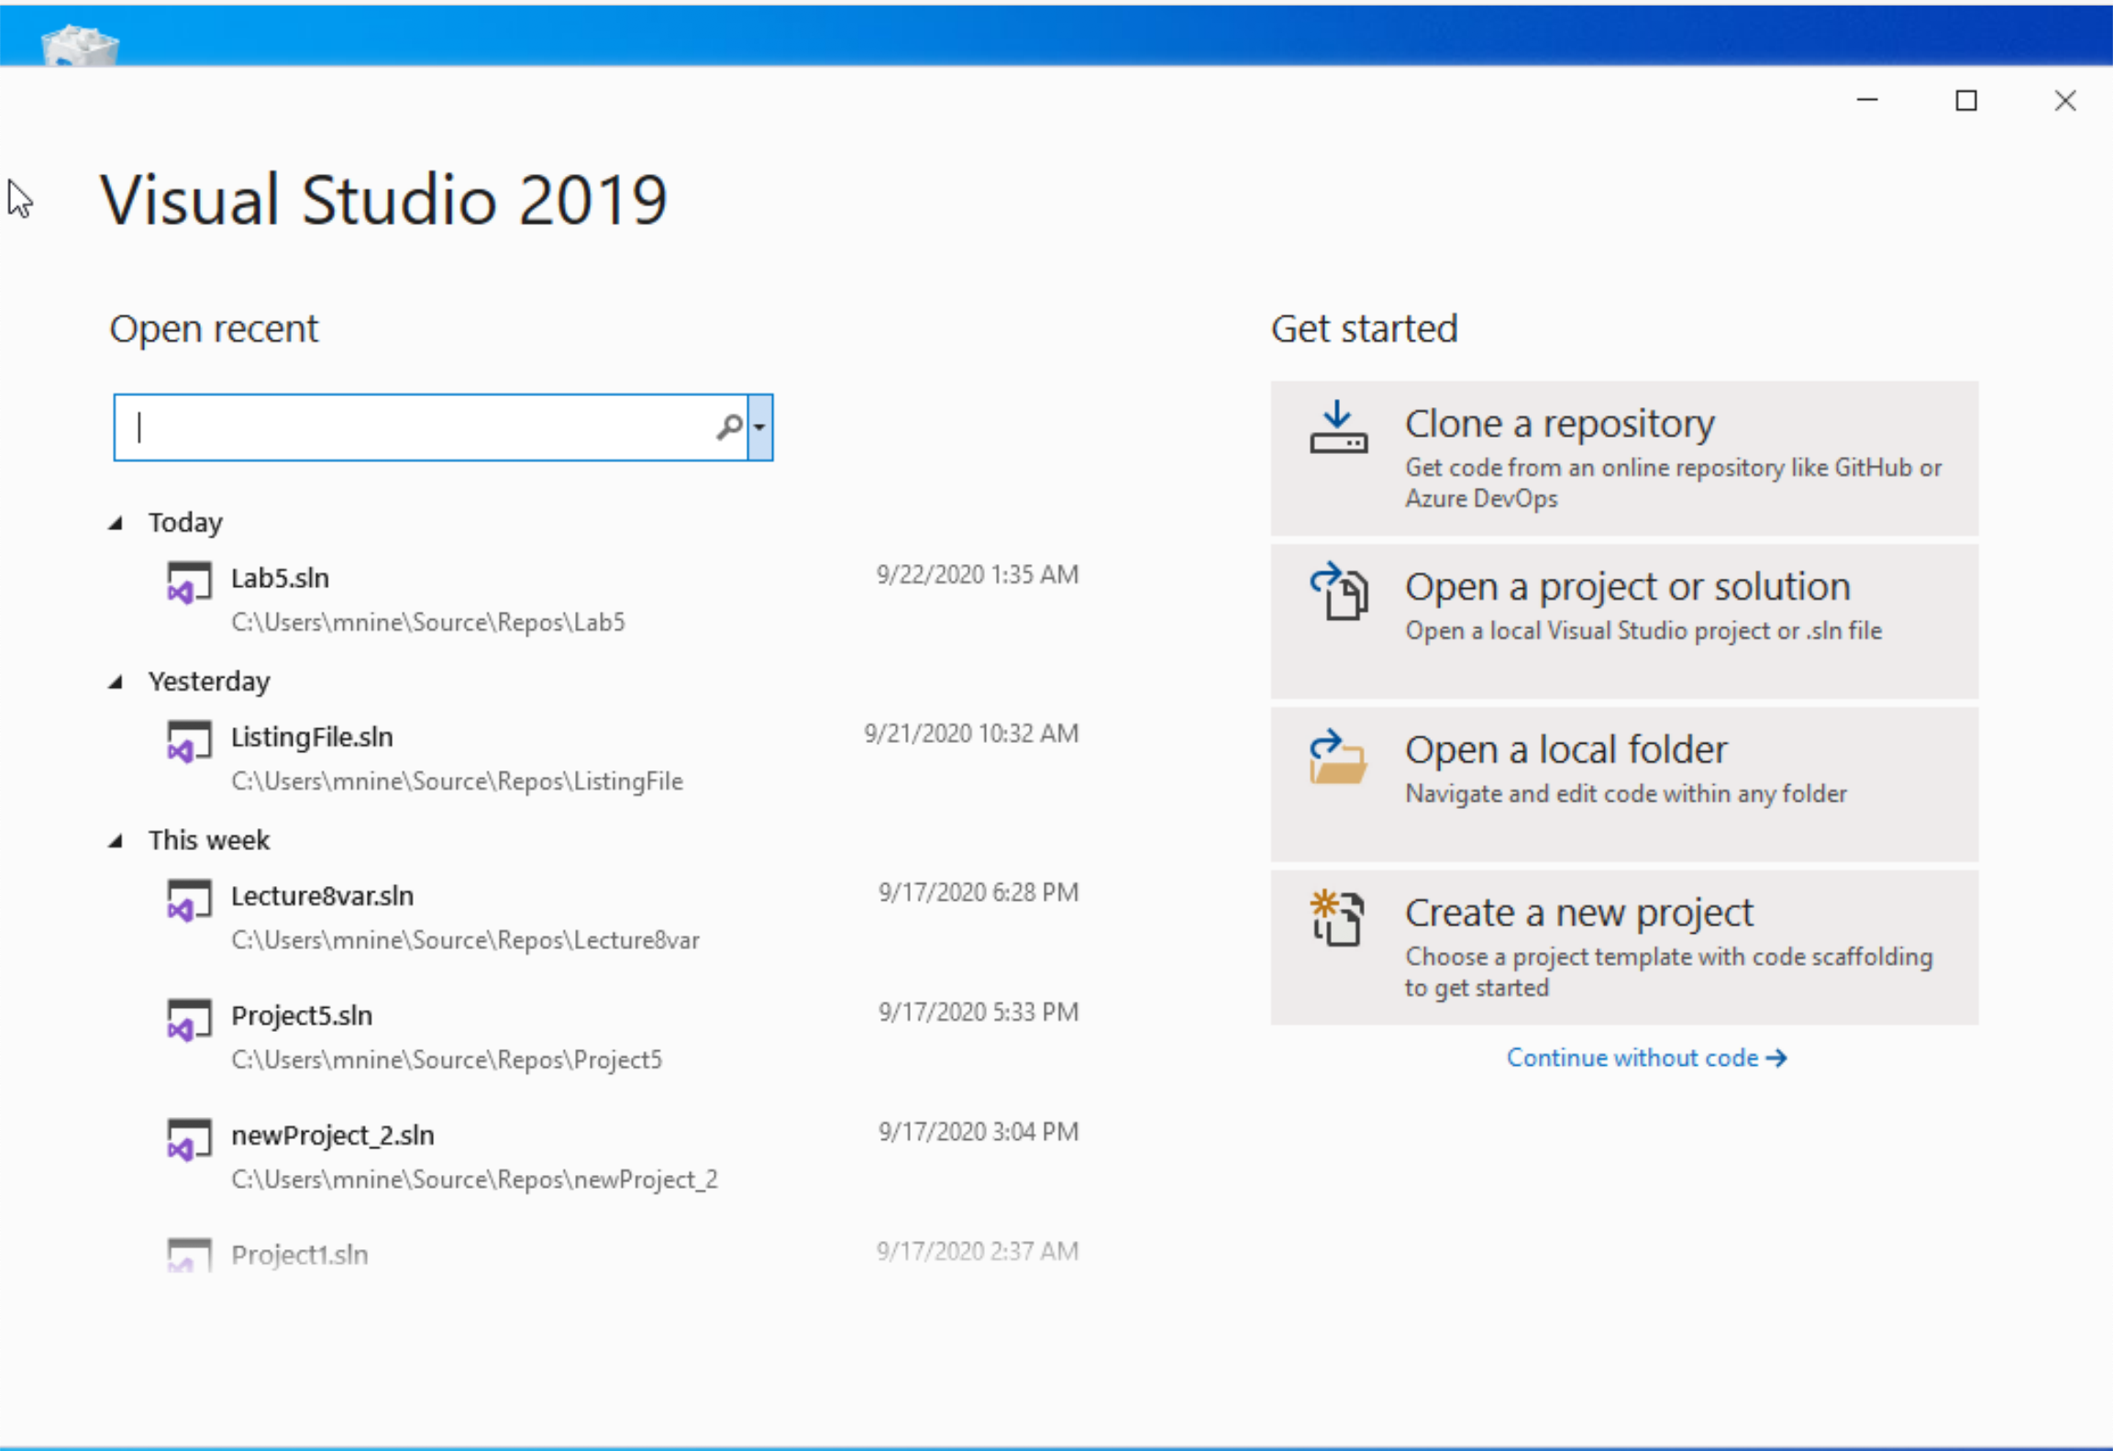


Step 1: Create a project (1)
Start Visual Studio
Click Create a new Project

Slide 27
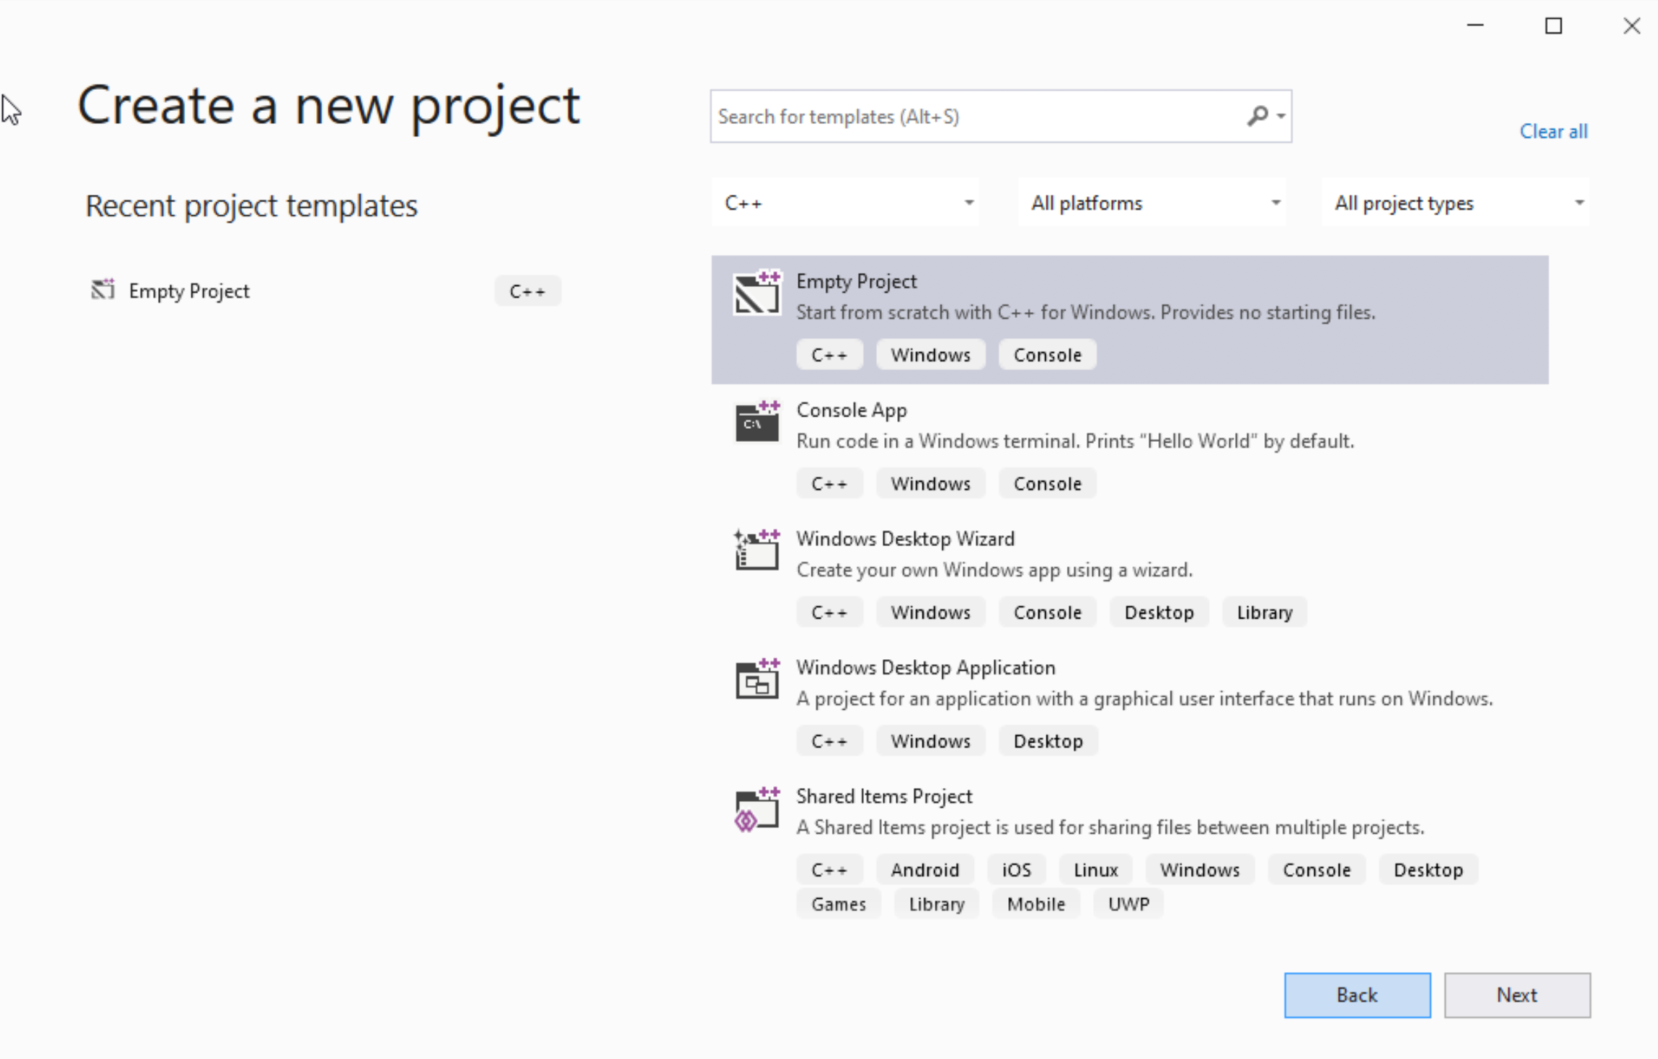




Step 1: Create a project (2)
Select C++ as language
Select Empty Project
Click Next

Slide 28
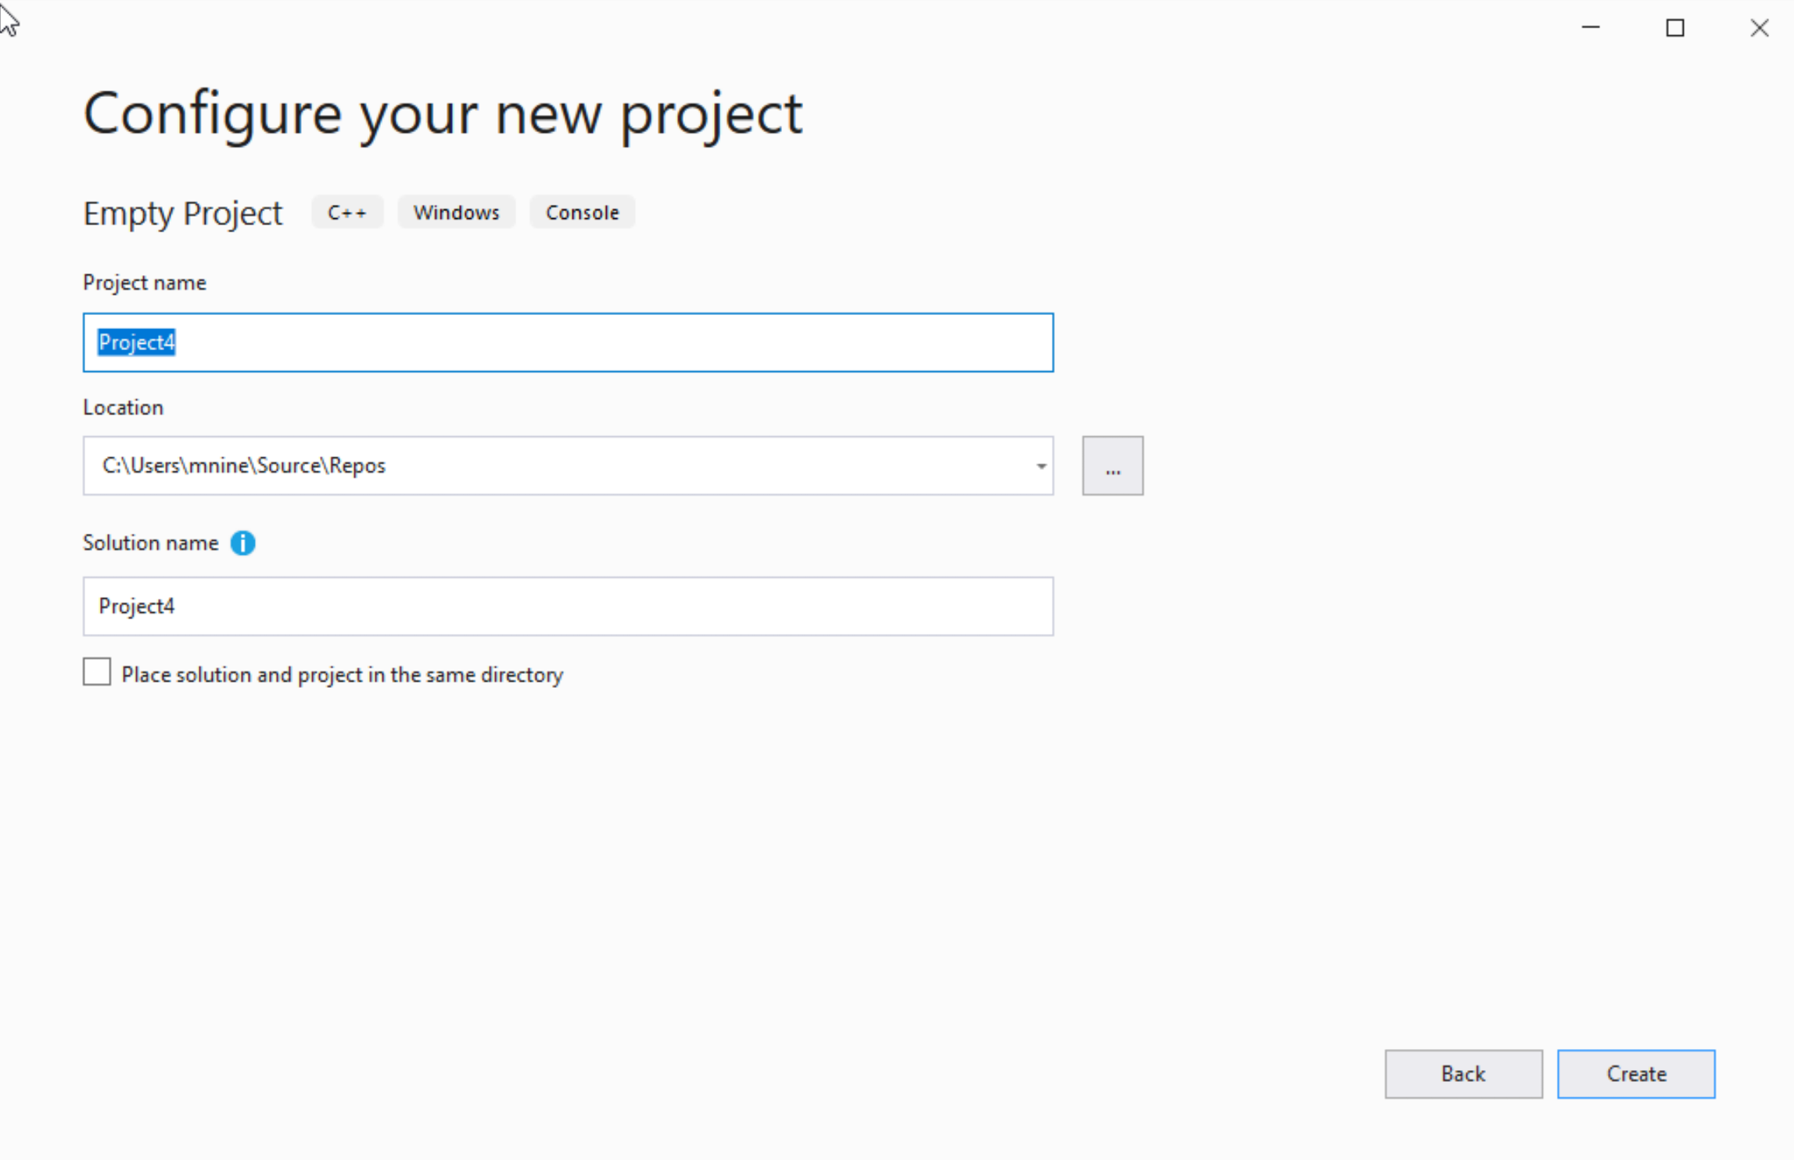

Step 1: Create a project (3)
You can change the project
name as you like
Also, you can change the
project location
Click Next

Slide 29
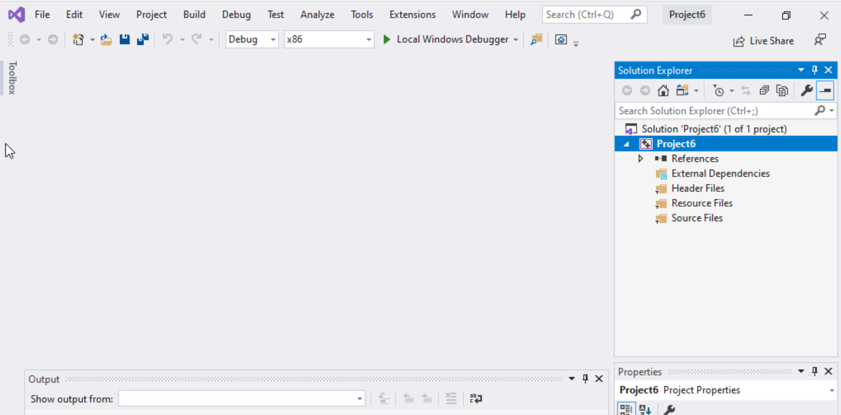
Step 1: Create a project (4)
Delete the
Following folders:
Header files
Resources Files, and
Source Files

Slide 30
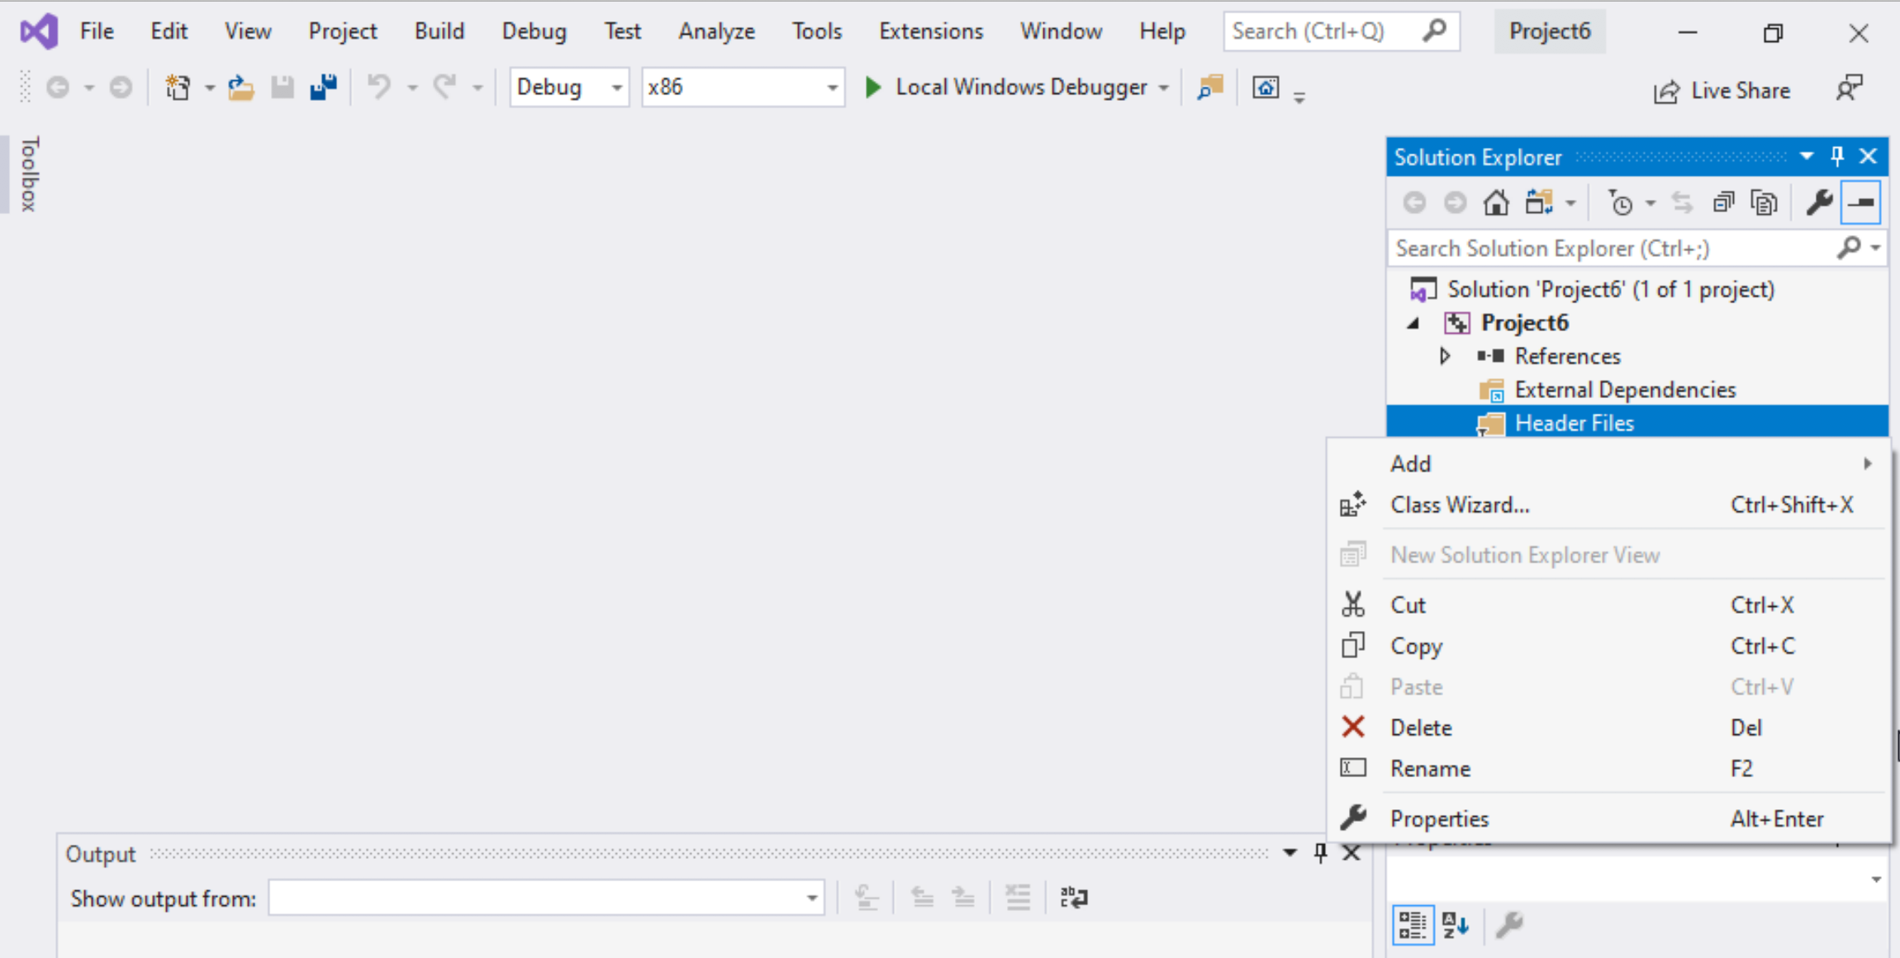
Step 1: Create a project (5)
To delete :
Select the folders
Right click on it
Select delete

Slide 31
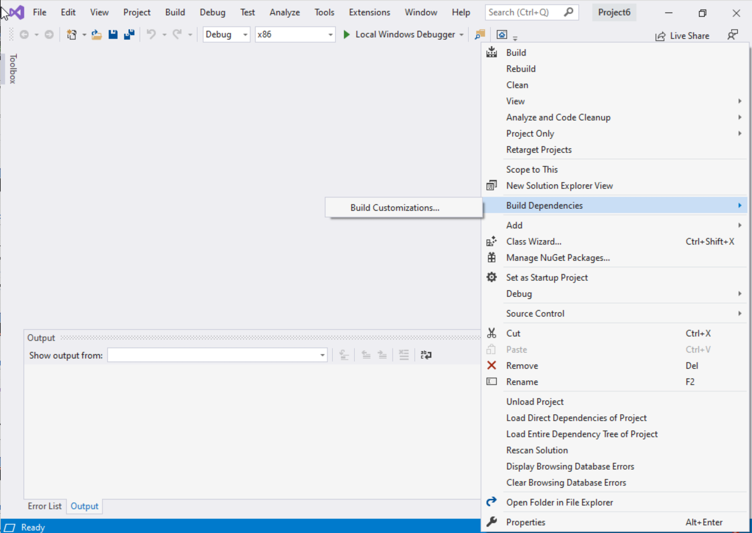
Step 1: Create a project (6)
Select Project Name on solution explorer
Right click on it
Go to Build Dependencies
Click on Build Customizations

Slide 32
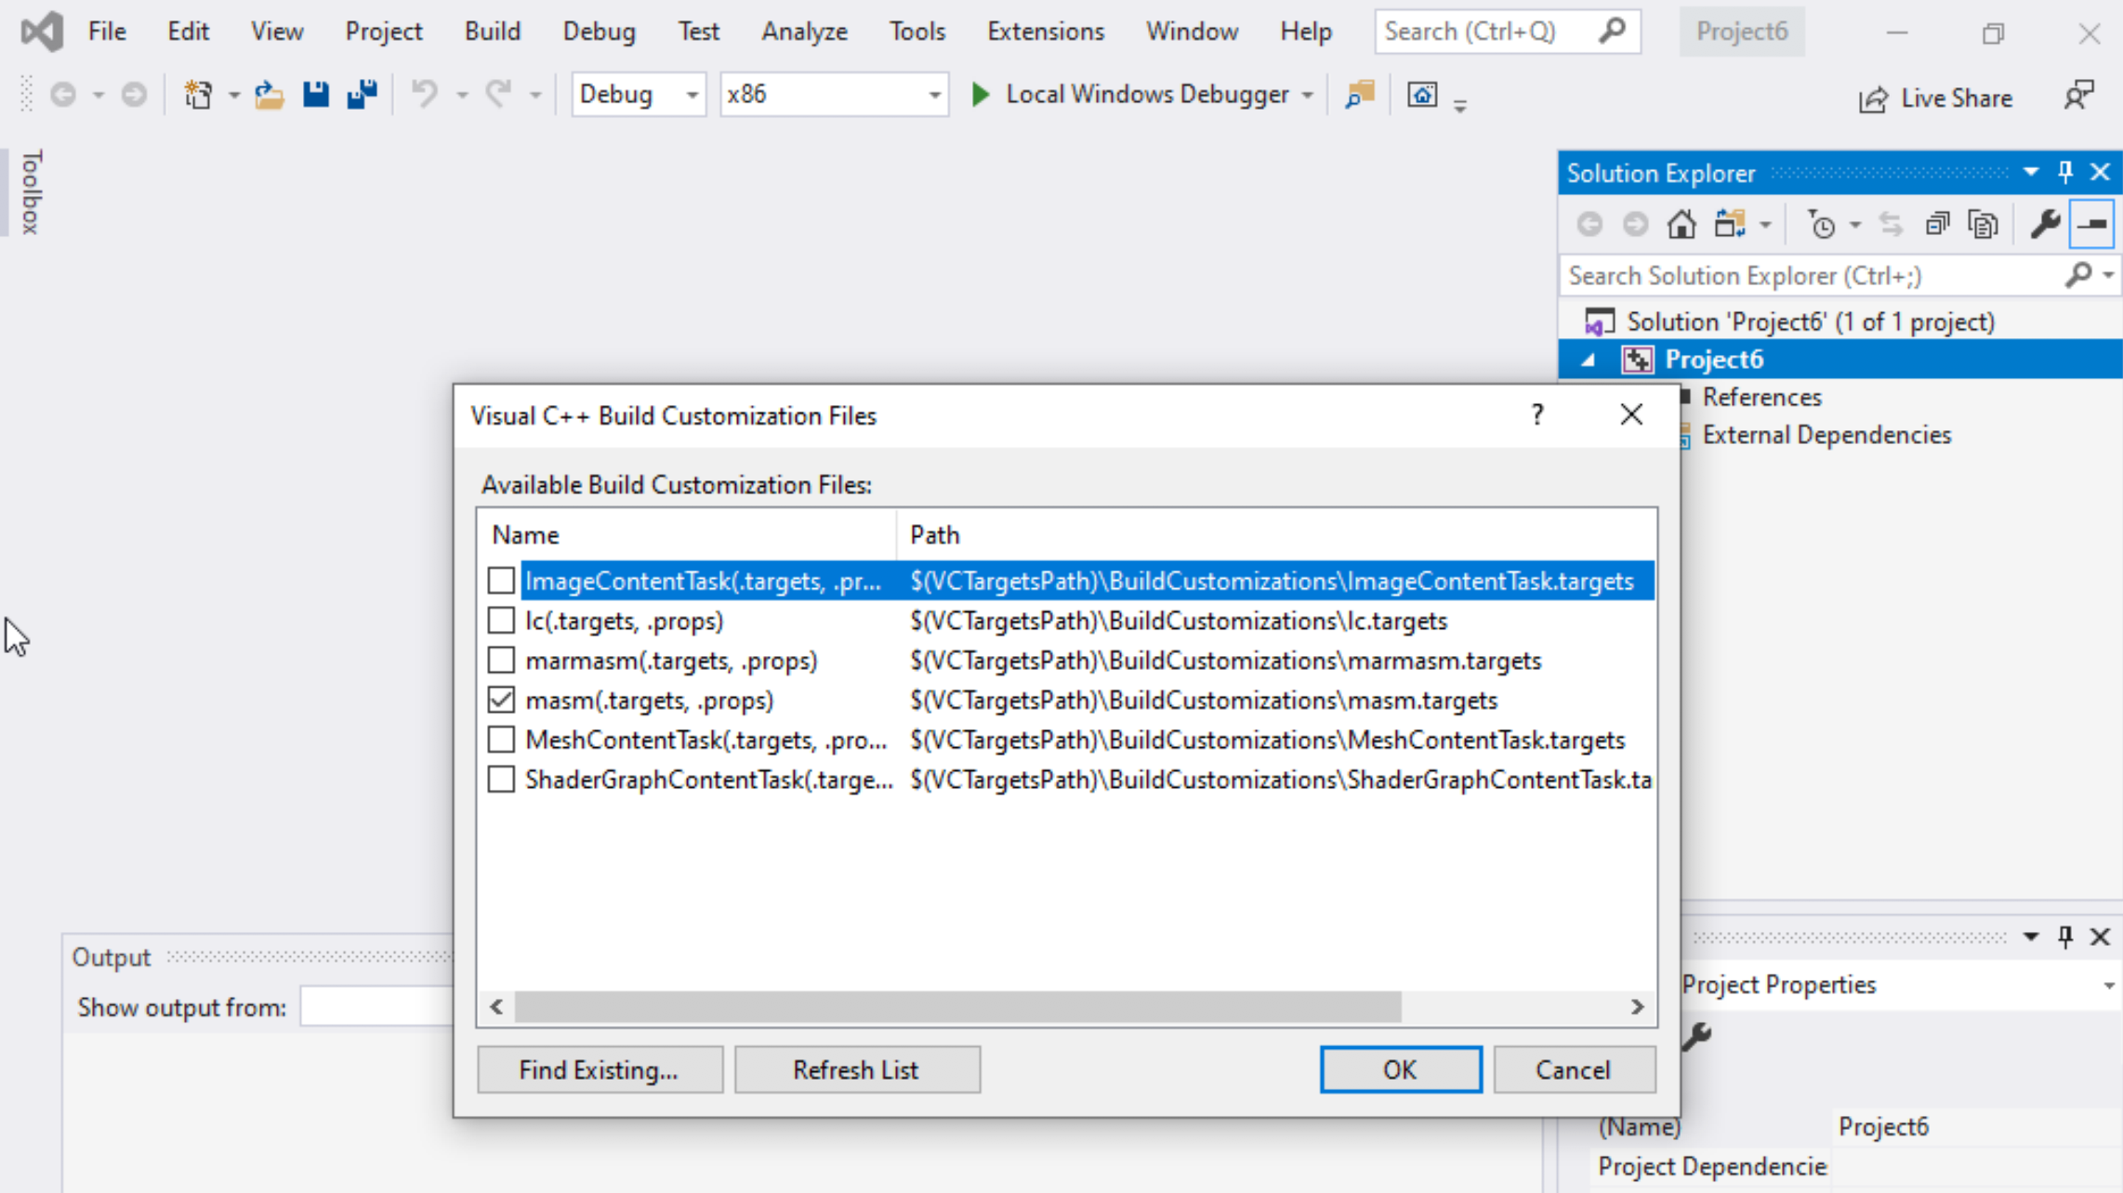
Step 1: Create a project (7)
Select masm(.target, .props)
Click ok

Slide 33
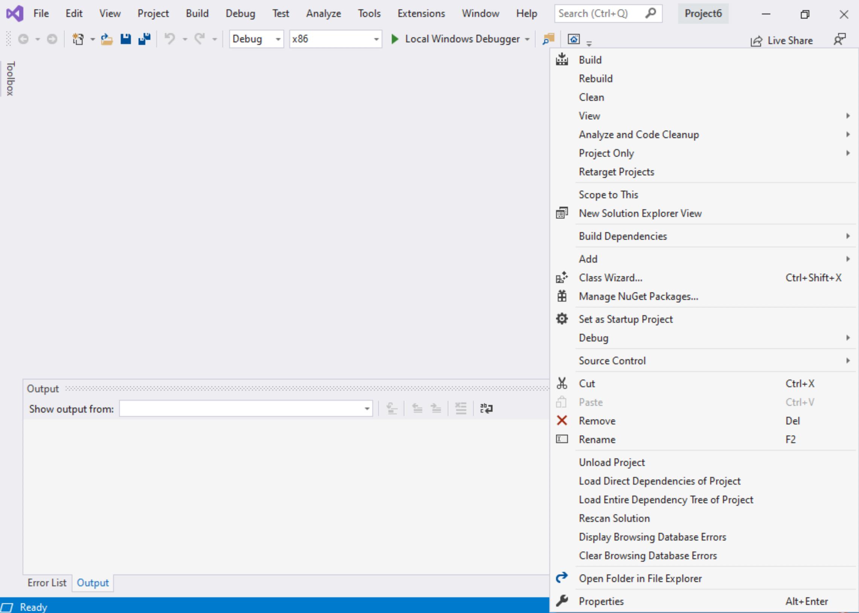
Step 1: Create a project (8)
Right click on the Project name in the solution explorer
Click properties

Slide 34
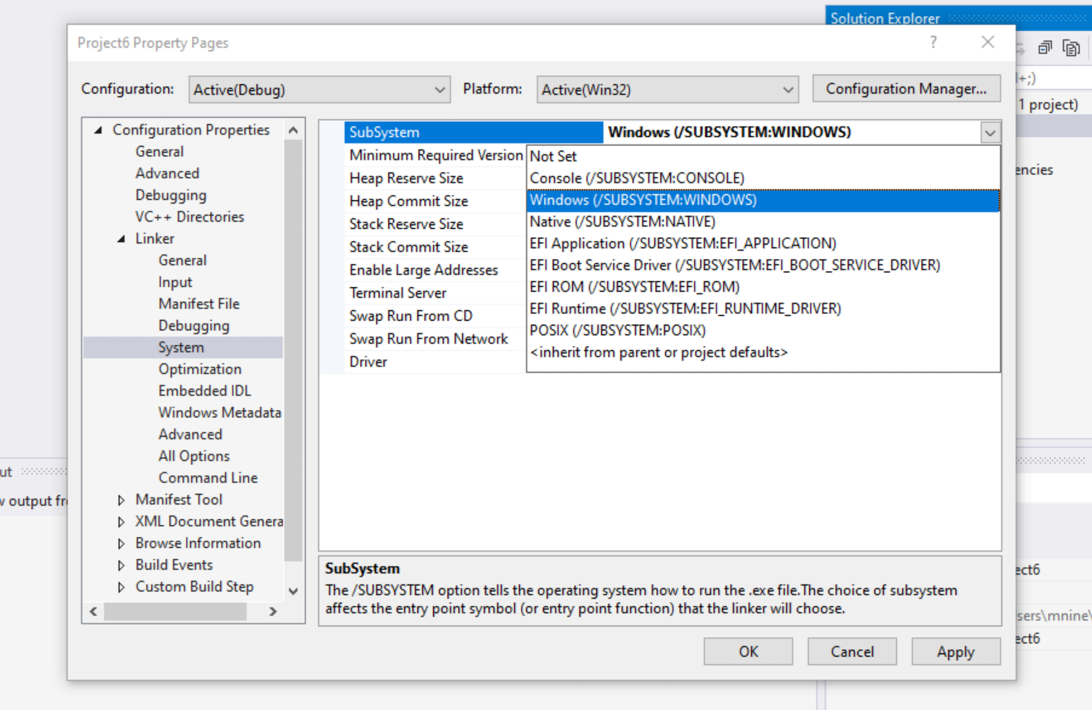

Step 1: Create a project (9)
Expand the ‘Linker’
Select ’System’
Select Windows(/SUBSYSTEM:WINDOWS)
Click OK

Slide 35
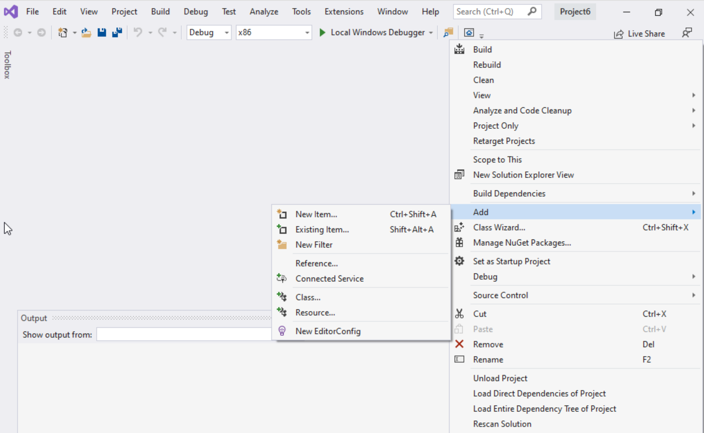
Step 1: Create a project (10)
Select Project name on solution explorer
Right click on it
Expand Add
Choose New Item

Slide 36
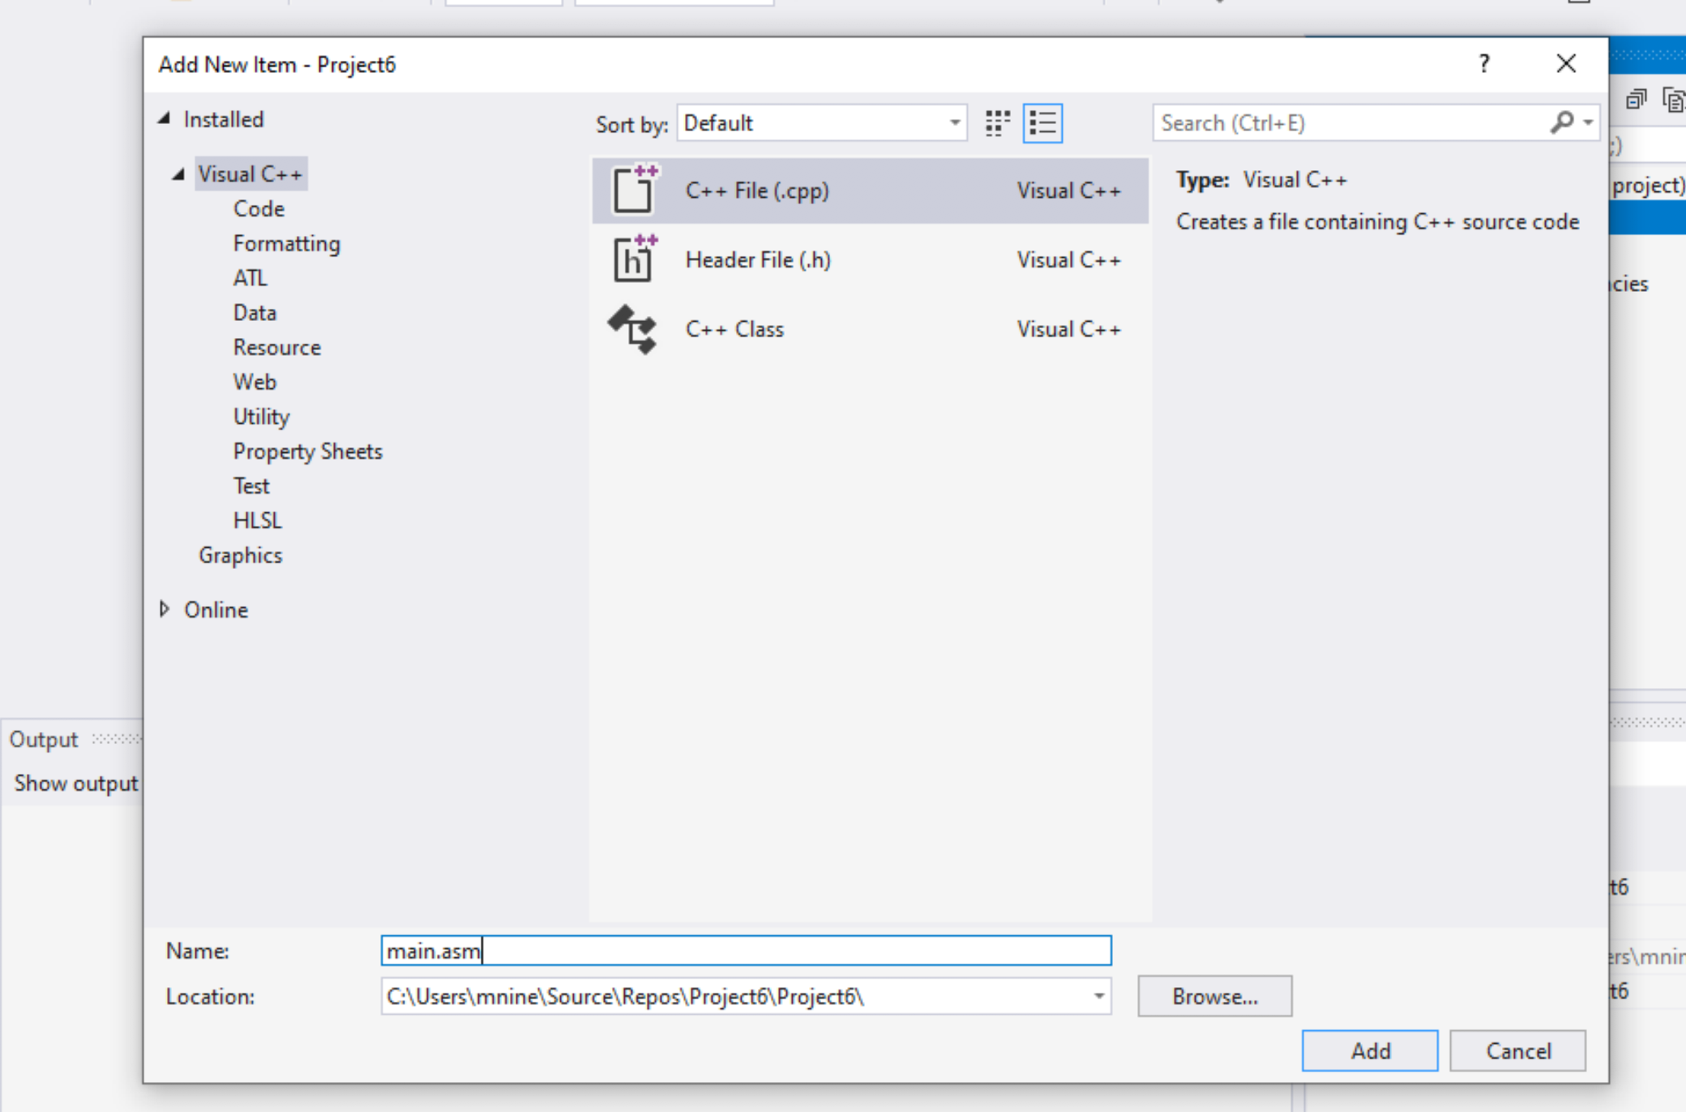


Step 1: Create a project (11)
Select C++ File(.cpp)
Name: main.asm
Click Add

Slide 37
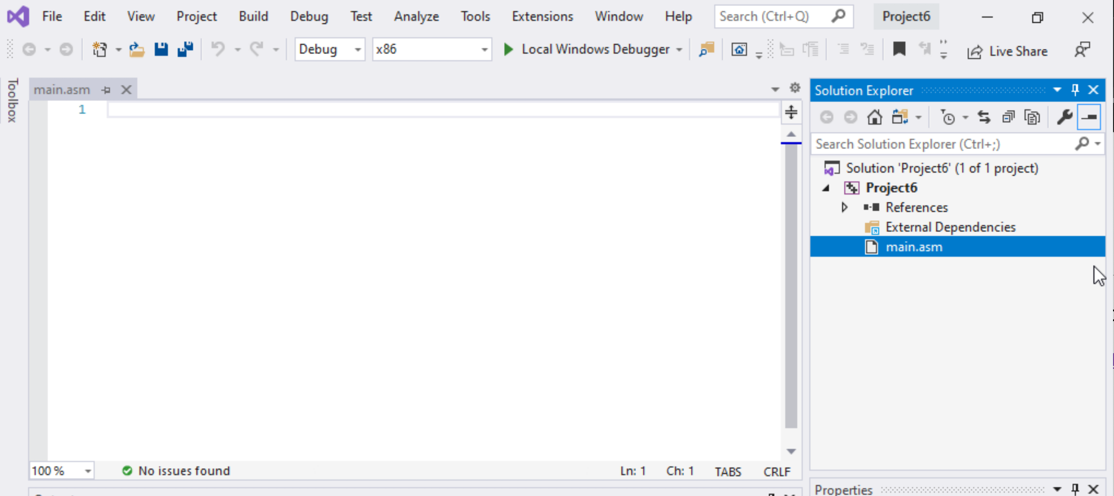

Step 1: Create a project (12)
Select main.asm
Add your code
In the main.asm File.

